Slide 1
SCIENTIFIC TEMPERAMENT AND logical thinking
A Presentation By : JOSWIN EMMANUEL
CSE B s1
Roll No - 41

Slide 2
TABLE OF CONTENTS
01
03
WHAT IS SCIENTIFIC TEMPERAMENT ?
QUOTES FROM FAMOUS PEOPLE.
02
04
WHAT IS LOGICAL THINKING ?
IMPORTANCE OF SCIENTIFIC TEMPERAMENT & LOGICAL THINKING.

Slide 3
01
WHAT IS SCIENTIFIC TEMPERAMENT ?
Scientific temperament is a state of mind which does not accept or believe anything but the truth and think logically and rationally.
Scientific temperament is the application of scientific method in day to day life, which include questioning, observing, physical reality, testing, analyzing and communicating.
Scientific temperament describe an attitude which involves the application of LOGIC. Discussion, argument and analysis are the vital part of scientific temperament.

Slide 4
02
WHAT IS LOGICAL THINKING ?
Two kinds of logical reasoning are often distinguished in addition to
formal deduction: induction and abduction. Given a precondition or
premise, a conclusion or logical consequence and a rule or material
conditional that implies the conclusion given the precondition, one
can explain the following.

Slide 5
DIFFERENT KINDS OF LOGICAL THINKING:
Deducative reasoning
Deductive reasoning determines whether the truth of a conclusion can
be determined for that rule, based solely on the truth of the premises.
EXAMPLE: "When it rains, things outside get wet. The grass is outside,
therefore: when it rains, the grass gets wet." Mathematical logic and
philosophical logic are commonly associated with this type of reasoning.
Inductive reasoning
Inductive reasoning attempts to support a determination of the rule. It
hypothesizes a rule after numerous examples are taken to be a conclusion
that follows from a precondition in terms of such a rule.
EXAMPLE: "The grass got wet numerous times when it rained, therefore: the
grass always gets wet when it rains." This type of reasoning is commonly
associated with generalization from empirical evidence. While they may be
persuasive, these arguments are not deductively valid: see the problem of induction.
Abductive reasoning
Abductive reasoning, sometimes called inference to the best explanation,
selects a cogent set of preconditions. Given a true conclusion and a rule,
it attempts to select some possible premises that, if true also, can support
the conclusion, though not uniquely.
Example: "When it rains, the grass gets wet. The grass is wet. Therefore,
it might have rained." This kind of reasoning can be used to develop a
hypothesis, which in turn can be tested by additional reasoning or data.
Diagnosticians, detectives, and scientists often use this type of reasoning.

Slide 6
03
QUOTES FROM FAMOUS PEOPLE.

Slide 7
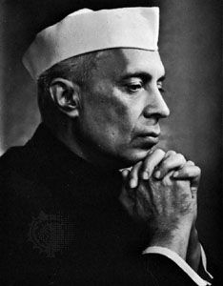
JAWAHARLA NEHRU in The Discovery of India, writes,
“Scientific temper is a way of life — an individual and social process of thinking and acting which uses a scientific method which may include questioning, observing reality, testing, hypothesising, analysing and communicating.”

Slide 8
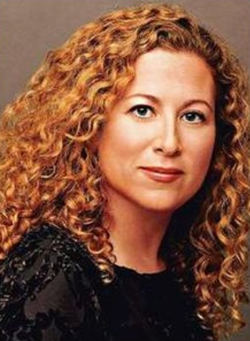
—JODI PICOULT
“Logical thinking keeps you from
wasting time worrying, or hoping. It
prevents disappointment.
Imagination, on the other hand, only
gets you hyped up over things that
will never realistically happen.”

Slide 9
04 IMPORTANCE OF SCIENTIFIC TEMPERAMENT & LOGICAL THINKING
Self Learning and Self Effort
Believe FACTS based on Evidences
Helps to Acquire new KNOWLEDGE
To Develop SCEPTICISM
Helps to Discipline our MIND
To Develop RATIONAL ATTITUDE
Helps to solve day to day problems
To Arouse CURIOSITY

Slide 11
THANKS!
Think for yourself,
not of yourself.
Think of others,
not for others.
-NAVAL RAVIKANT

